Slide 1

Analyzing the Mets Pitching
Charles Dvorak | Jack O’Connor | Richard Bump | Sam Witham

Slide 2


Introduction
Can advanced analytical techniques be deployed to identify strengths and weaknesses in the New York Mets pitching staff
The following scouting report is prepared in anticipation of an upcoming home & away series for the New York Mets. The analysis seeks to identify areas that opposing batters may be able to exploit and therefore gain a competitive advantage against the pitching staff.

Slide 3
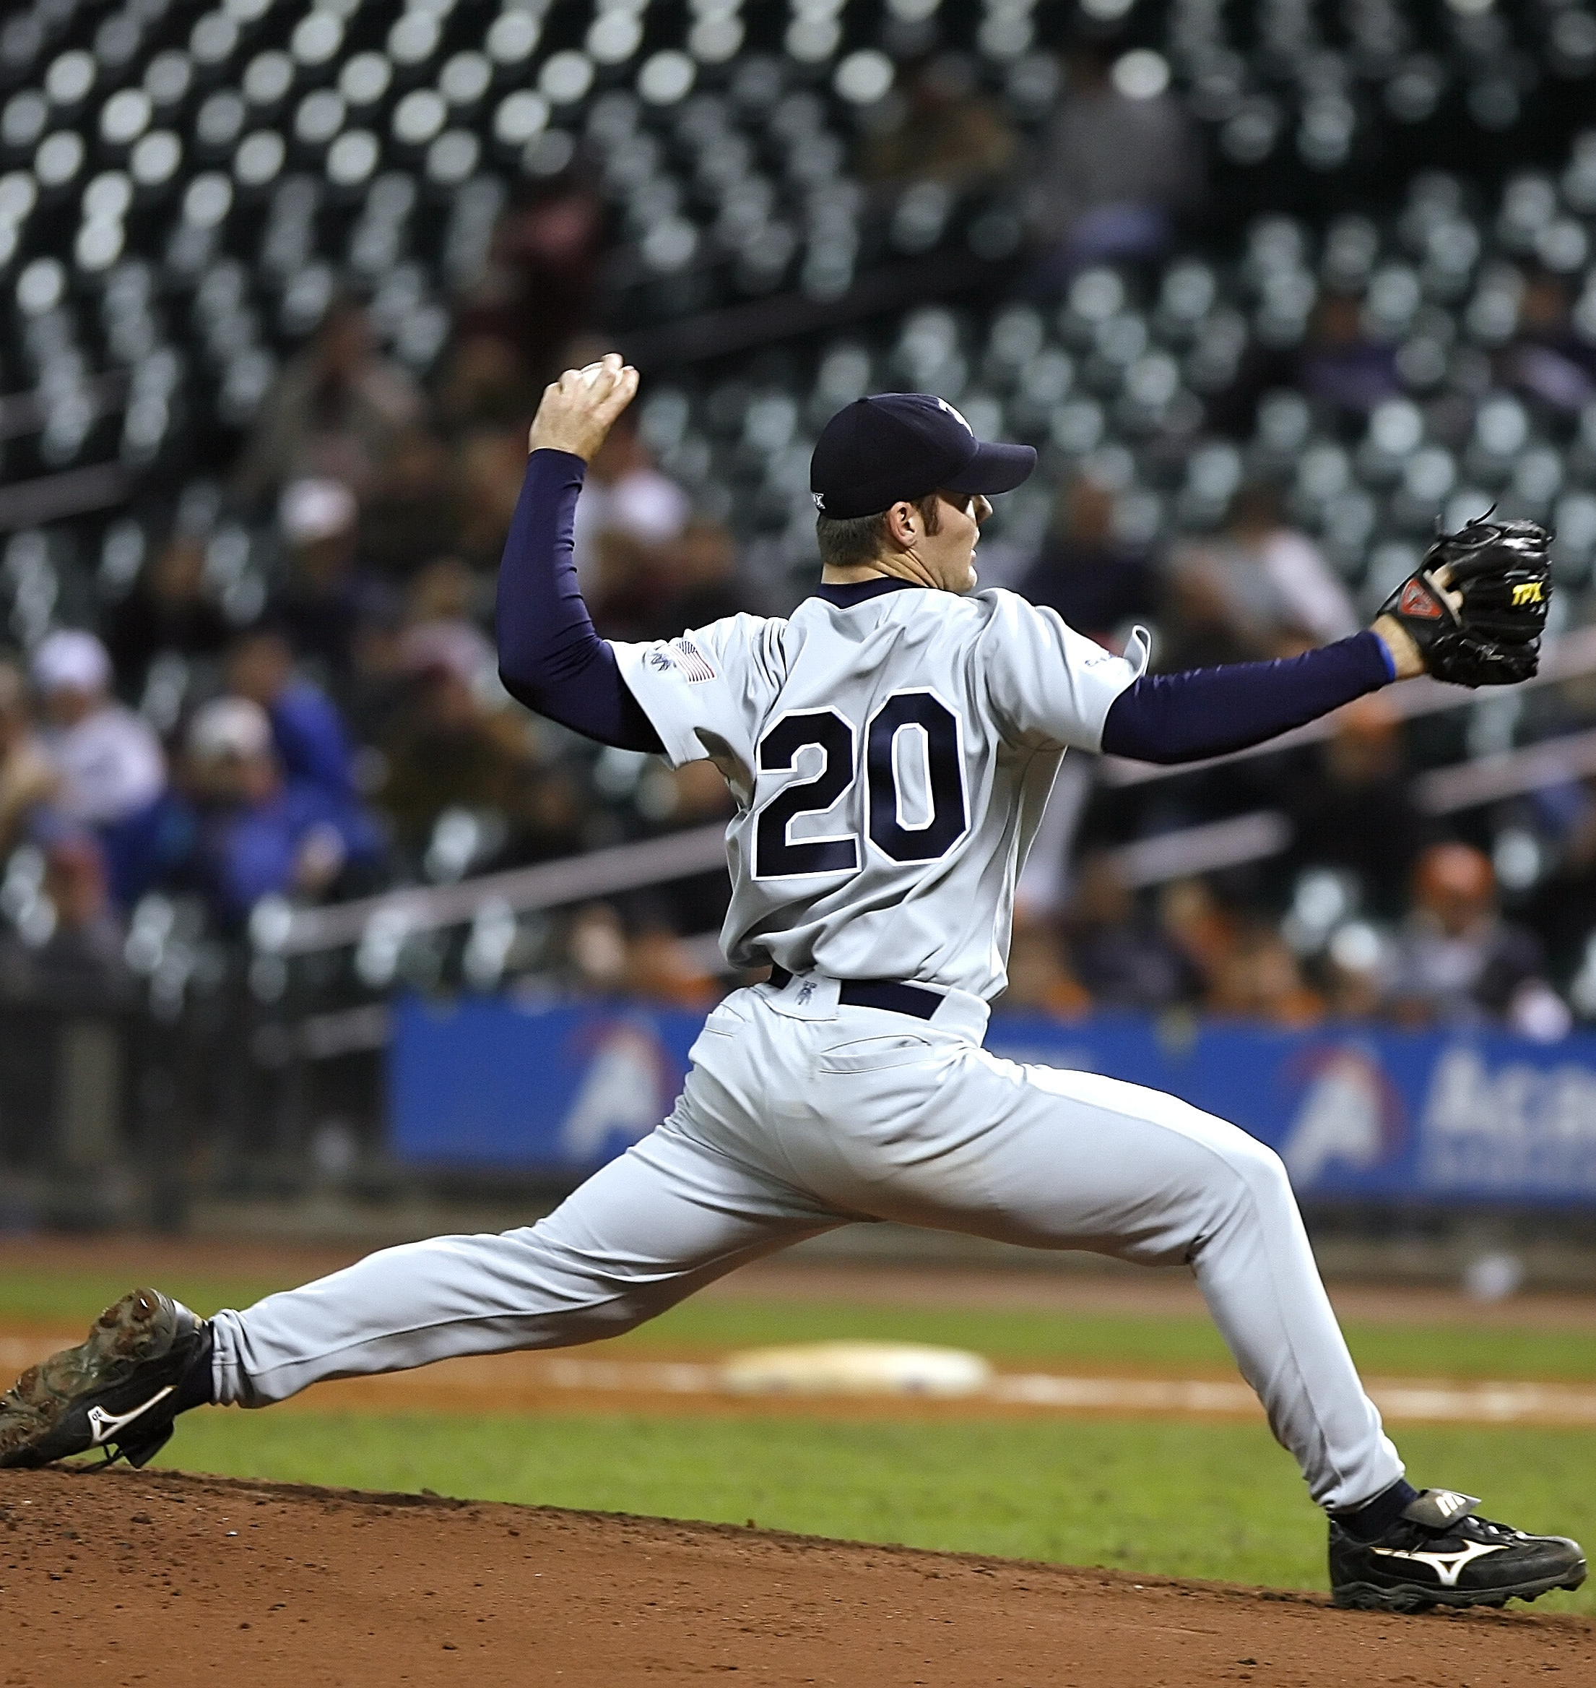
About the Data
Pitchers
Starters
This dataset consists of a detailed account of over 30,000 pitches, delivered by five different New York Mets pitchers over the 2017, 2018, and 2019 seasons.
Noah Syndergaard
Jacob deGrom
Marcus Stroman
Pitchers: 5
Seasons: 3
Pitches: 31,442
At bats: 8,070
Batters: 729
Attributes: 89
Bullpen
Edwin Diaz (CL)
Seth Lugo
https://baseballsavant.mlb.com/

Slide 4

Exploratory Data Analysis
Objective: Identify high-level trends in pitcher performance

Slide 5
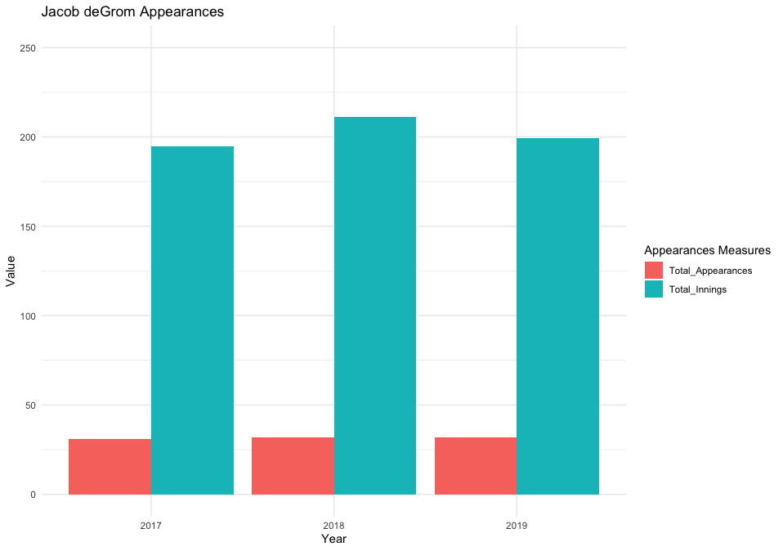
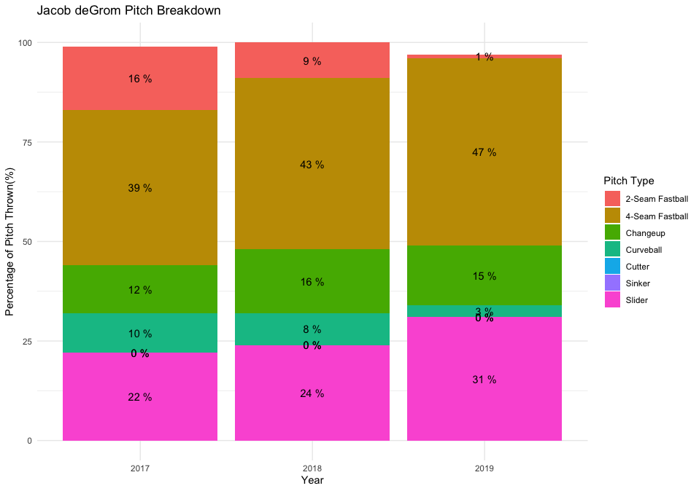
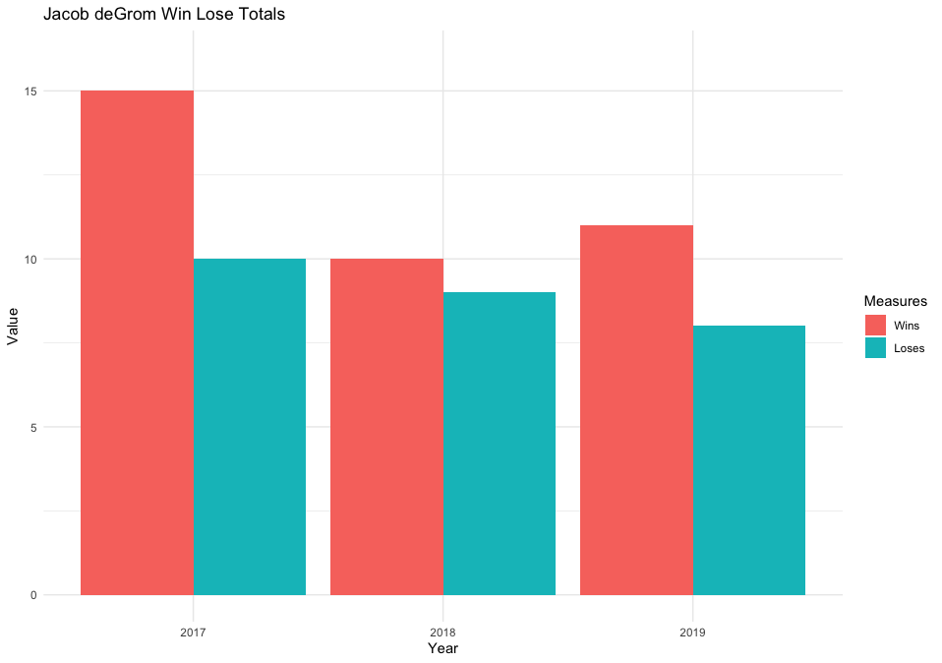
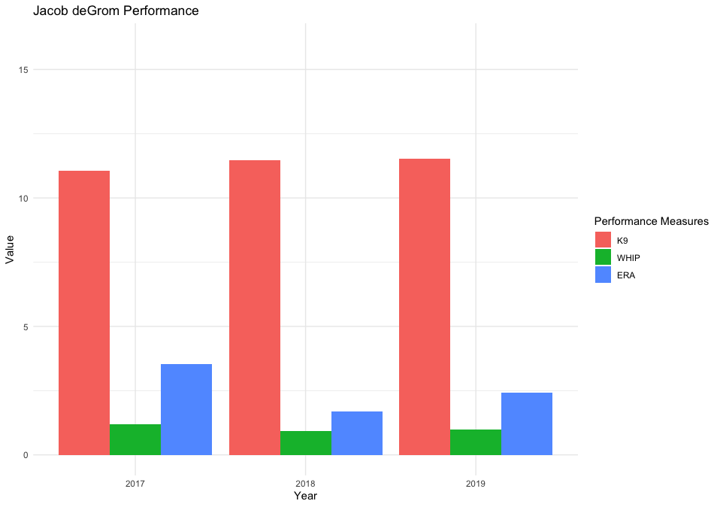
Jacob deGrom

Slide 6
Clustering
Objective: Classify pitches by observable variables

Slide 7
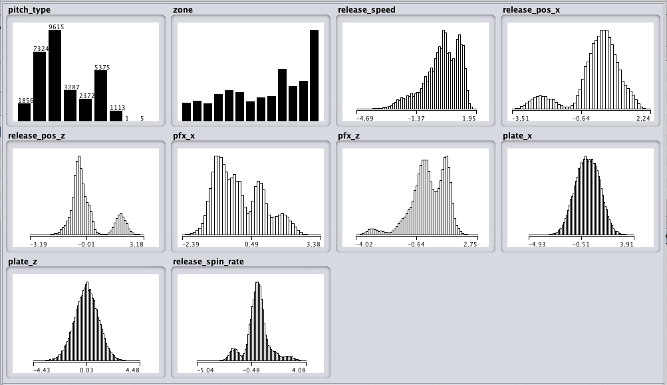
Variable Distribution

Slide 8
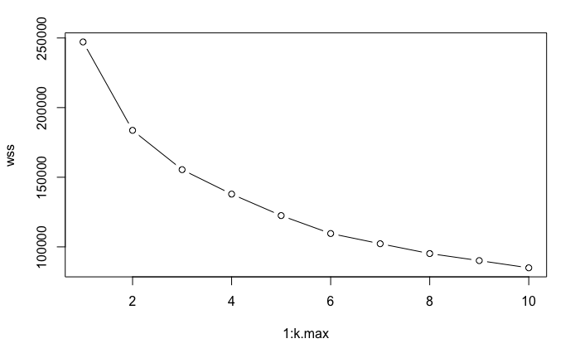
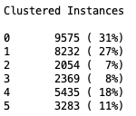
K-Means
Elbow method

Slide 9
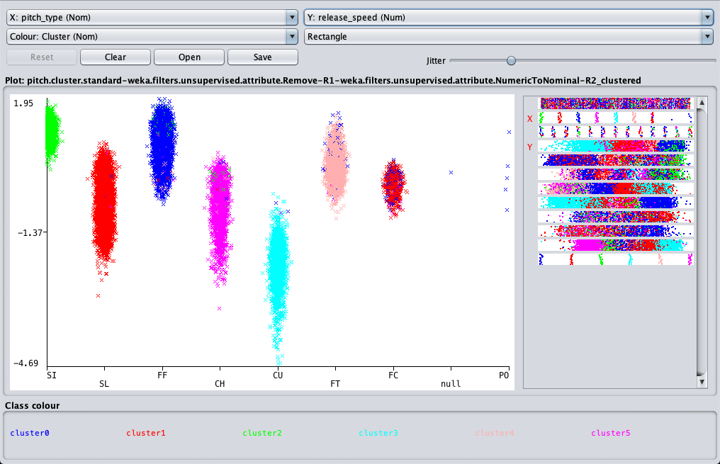
Pitch Type – Euclidean Distance

Slide 10
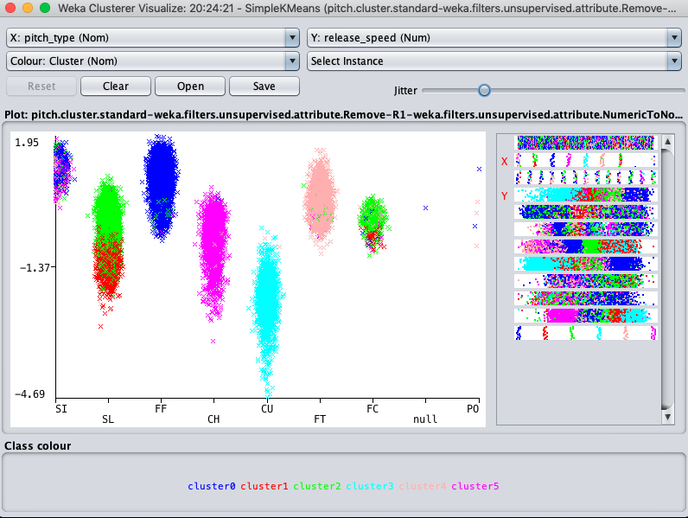
Pitch Type – Manhattan Distance

Slide 11
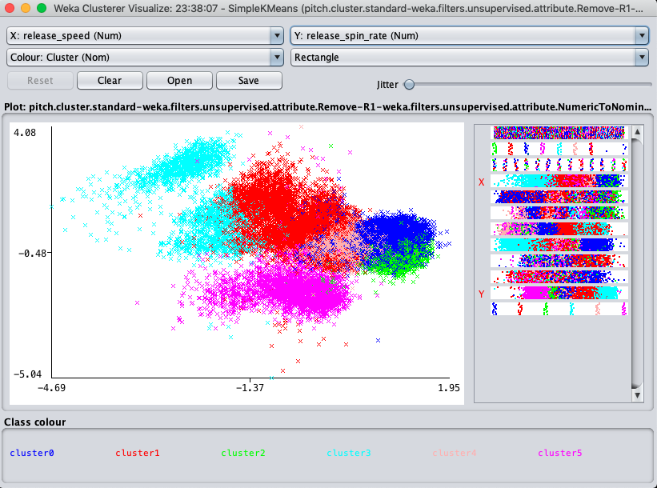
Pitch Speed – Euclidean Distance

Slide 12
Naïve Bayes
Objective: identify pitch attributes that result in a swing or non-swing

Slide 13
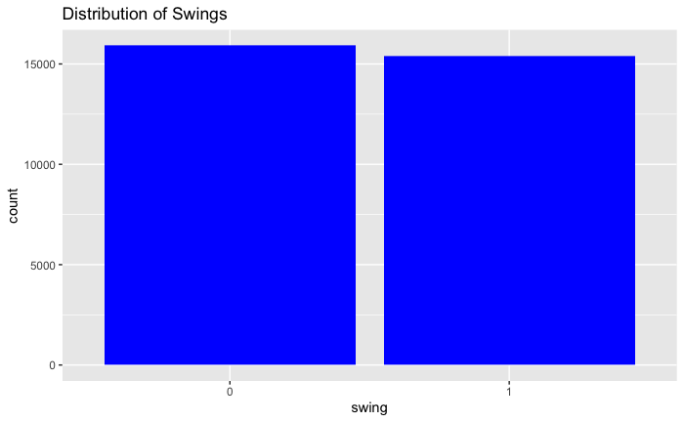

Slide 14
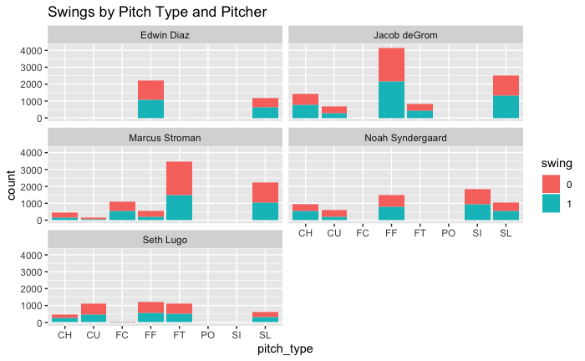
CH = Changeup
CU = Curveball
FC = Fastball (Cutter)
FF = Four-seam Fastball
FT = Two-seam Fastball
PO = Pitch Out
SI = Sinker
SL = Slider

Slide 15
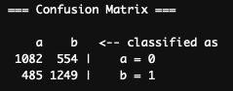
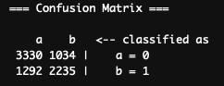
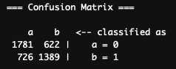
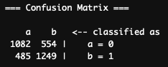
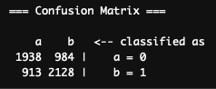
Model Accuracy by Pitcher
DeGrom
Accuracy: 68.9%
Stroman
Accuracy: 70.5%
Lugo
Accuracy: 70.2%
Diaz
Accuracy: 69.2%
Syndergaard
Accuracy: 68.2%

Slide 16
Decision Tree
Objective: Determine if pitch type may be easily predicted by opponents by game situation

Slide 17
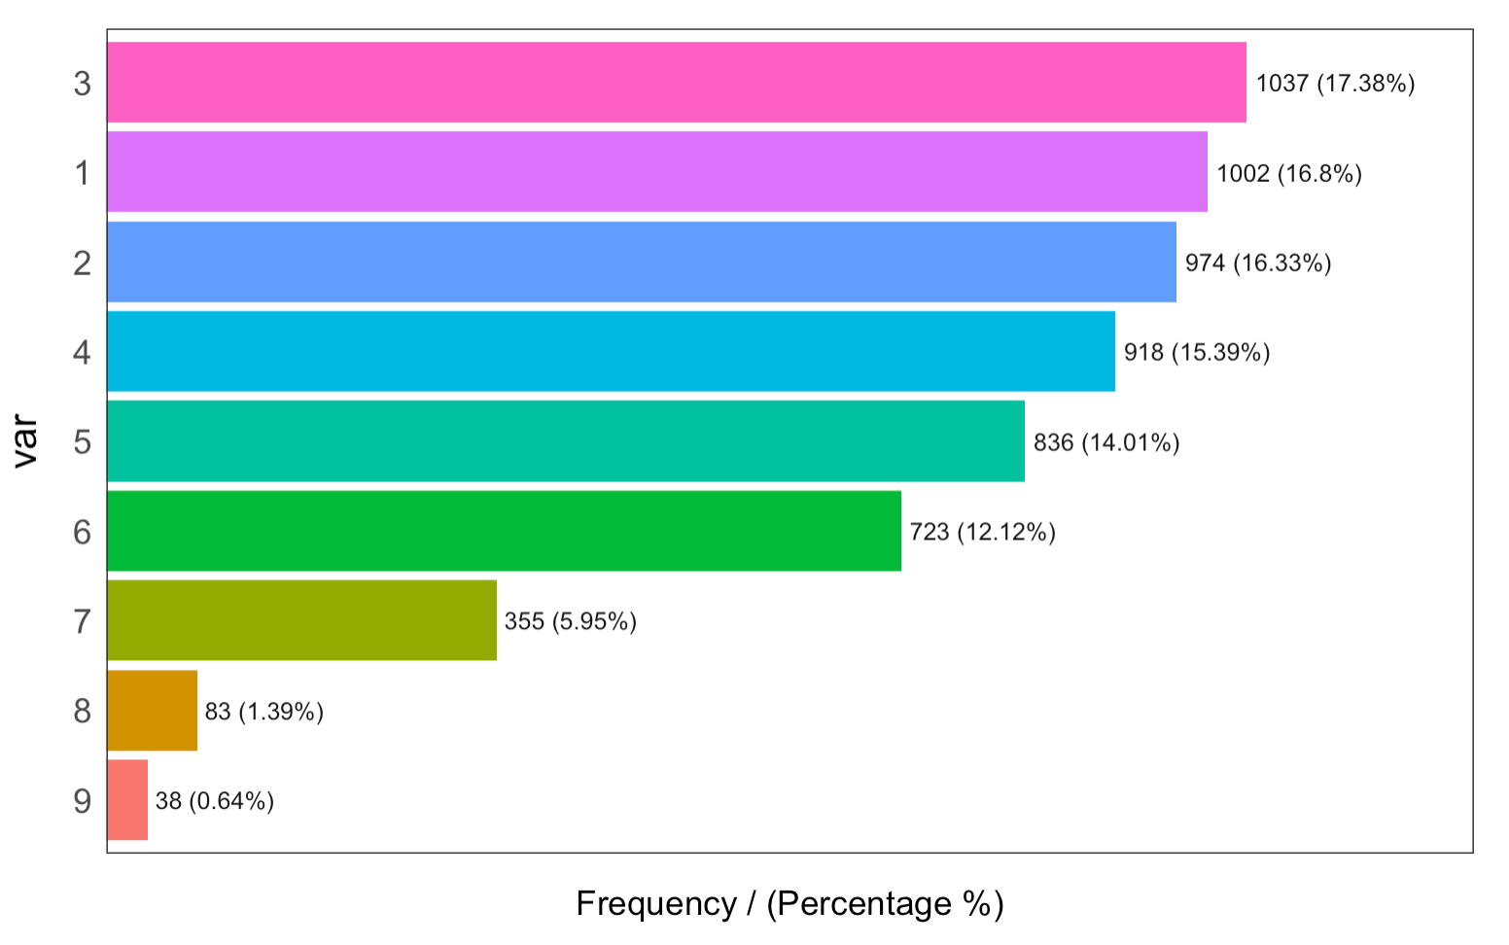
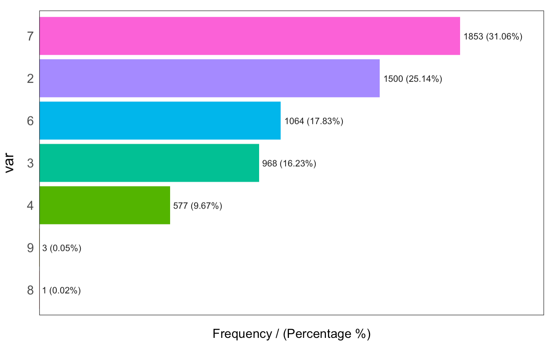
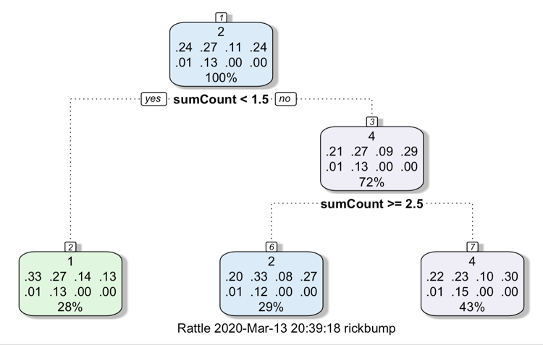
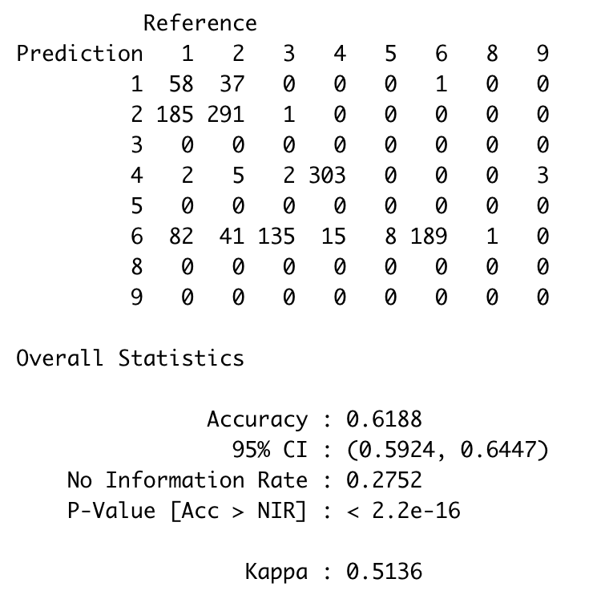
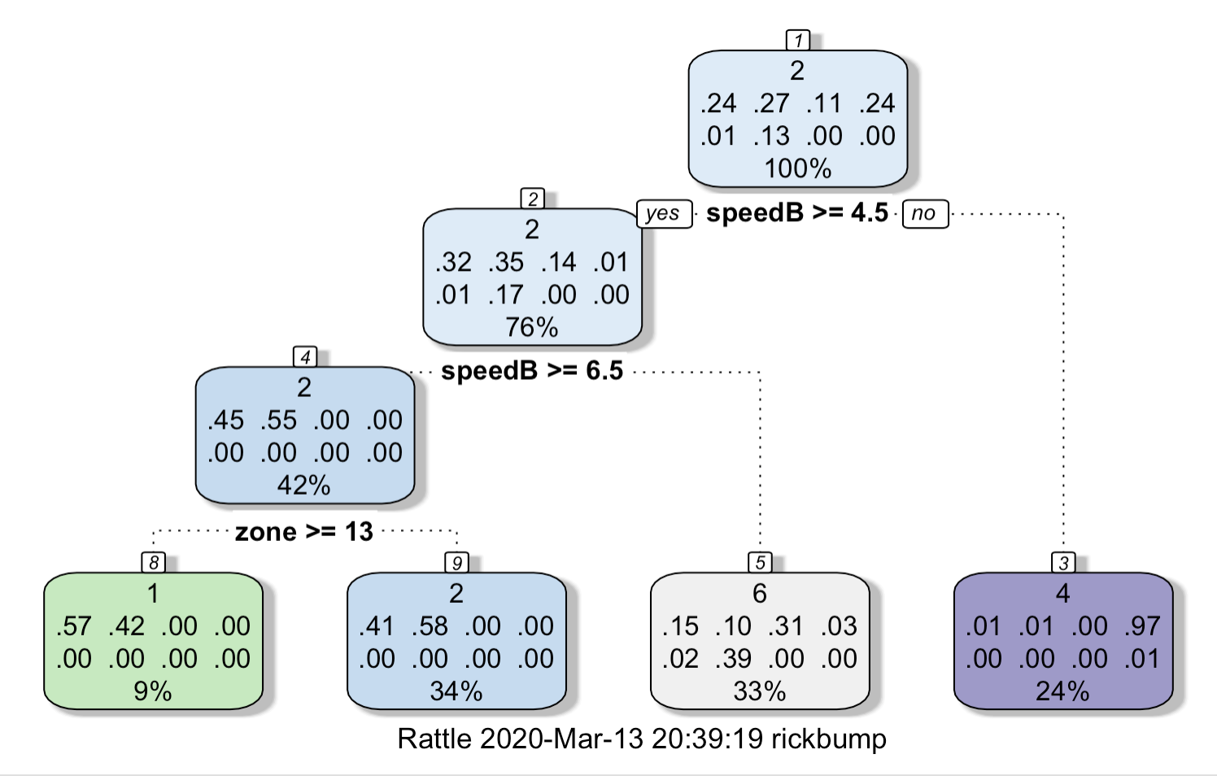
Pitch Prediction – Syndergaard Decision Tree Analysis
Syndergaard is a starter who pitches mostly in the earlier innings throwing most his pitches between 90 to 100mph. While he has 7 pitches, he throws mostly his sinker and his 4-seam fastball.
syndergaardTree2 <- pitch_name ~ sumCount + outs +scoring + inning
When Syndergaard is even or behind in the count (69% of the time), the batter has a 35% chance of seeing a slider and a 25% chance of seeing a 4-seam fastball. When Syndergaard is ahead in the count the batter has a fairly even likelihood of seeing a 4-seam fast ball (26%), a slider (24%) or a slider (23%).
lugoTree3 <- rpart(pitch_name ~ zone + speedB, data=lugoData)
While the overall model does not have a very high accuracy rate, 61.88% there are some observations that might add some insight. In anticipating the pitch, if Lugo throws a curveball, there is a very high likelihood that it will be slower than 85mph. It is highly likely that his sliders will come in between 80 and 90. The 2-seam and 4-seam fast balls are coming in over 90mph. about 21% of the fastballs are low.

Slide 18
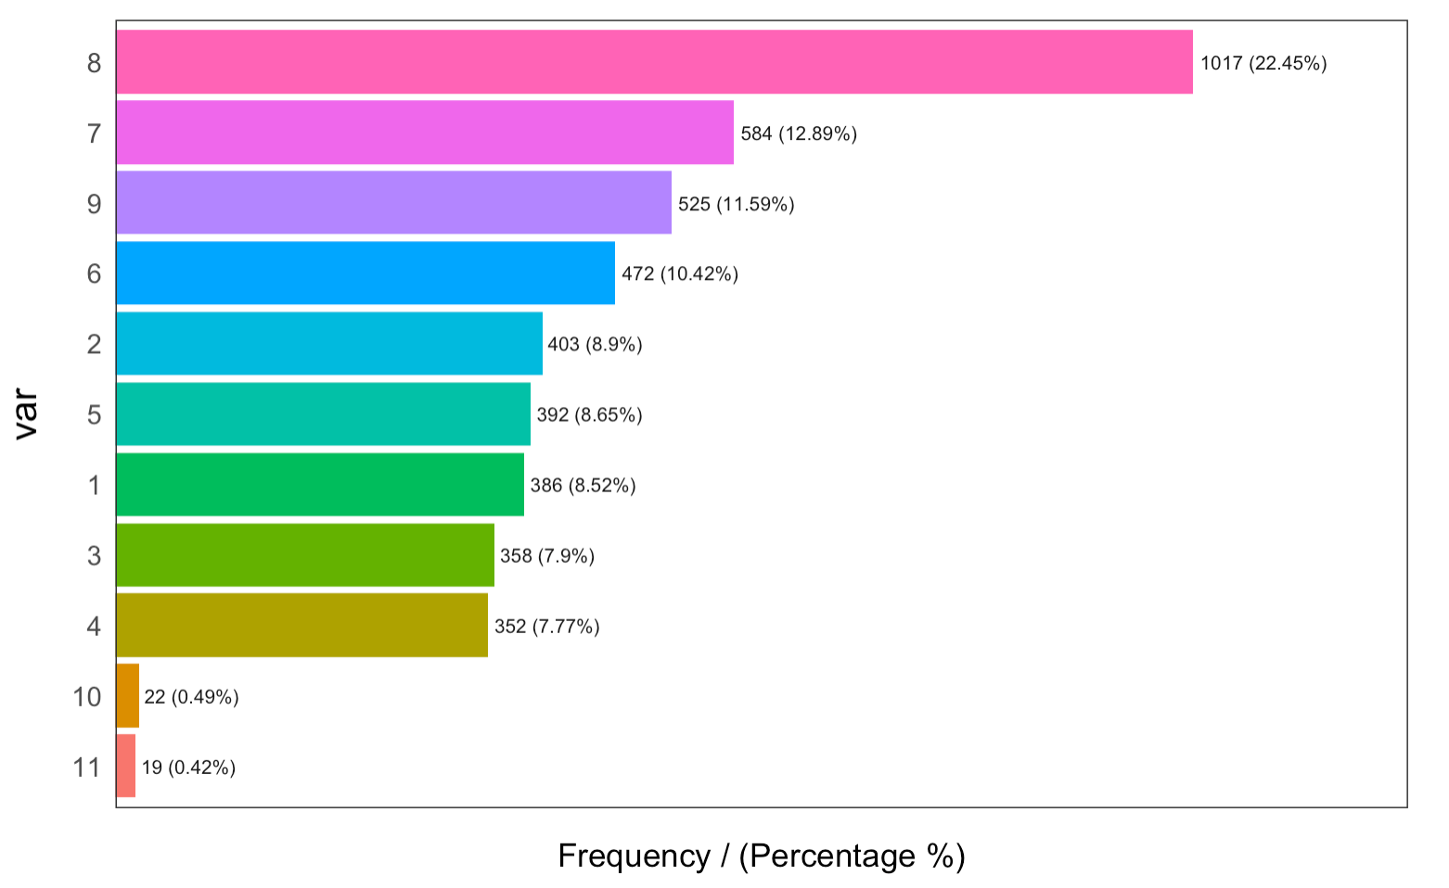
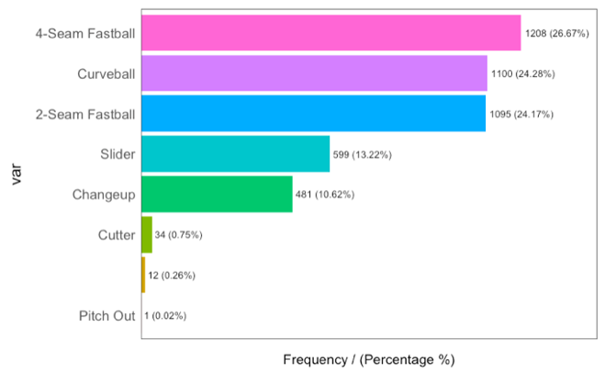
Pitch Prediction – Lugo Decision Tree Analysis
Lugo is a reliever with a wide range of pitches who comes in in the later innings.
lugoTree2 <- rpart(pitch_name ~ sumCount + outs +scoring + inning, data=lugoData)
Looking for pitch prediction based on the count, if Lugo is behind (balls > strikes) there is a 33% chance that he throws a 2-seam fast ball and a 27% chance that he throws a 4-seam fast ball (60% chance he throws a fast ball). If he is even in the count (balls = strikes), there is a 53% (20% 2-seam and 33% 4-seam) chance that he throws a fastball. The other pitch to watch for is a curveball (27% chance). If Lugo is ahead in the count (which is usually is at 5=43% of the time) the top 3 pitches are a fast ball (2-seam at 22% and 4-seam at 23%) combined for 43% but the curveball is the next pitch to watch for at 30%. Difficult to make a prediction here.
lugoTree3 <- rpart(pitch_name ~ zone + speedB, data=lugoData)
While the overall model does not have a very high accuracy rate, 61.88% there are some observations that might add some insight. In anticipating the pitch, if Lugo throws a curveball, there is a very high likelihood that it will be slower than 85mph. It is highly likely that his sliders will come in between 80 and 90. The 2-seam and 4-seam fast balls are coming in over 90mph. about 21% of the fastballs are low.

Slide 19
Association Rule Mining
Objective: Determine if pitch type may be easily predicted by opponents by game situation

Slide 20
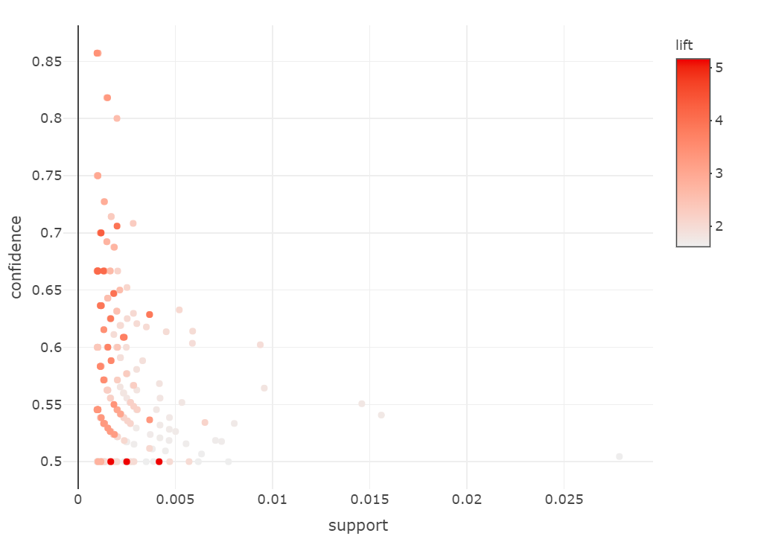
Association Rules
By pitcher:
Inning
Outs
Count
Baserunners
Batter Stance

Slide 21
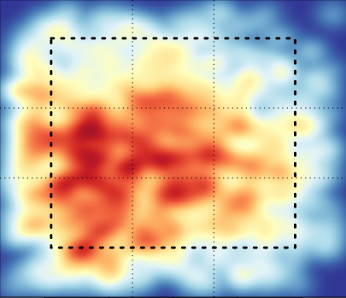
Syndergaard - Sinker
{inning=1,outs=0,count=0 - 0,bases=100}
=>{pitch_name=Sinker}
Support = 0.002011398
Confidence = 0.80000
Lift = 2.575715

Slide 22
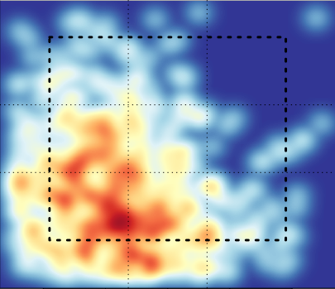
Syndergaard – Changeup
{bat_side=L,count=1 - 0,bases=120}
=>{pitch_name=Changeup}
Support = 0.001843781
Confidence = 0.6470588
Lift = 3.987968

Slide 23
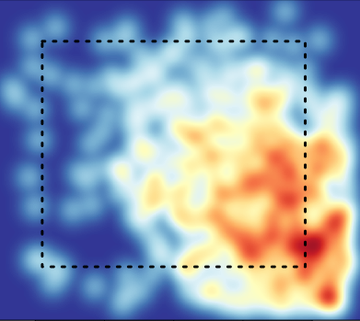
Syndergaard - Slider
{inning=4,outs=0,bat_side=R, count=0 - 1}
=>{pitch_name=Slider}
Support = 0.002179014
Confidence = 0.5416667
Lift = 3.037202

Slide 24
Support Vector Machines
Objective: Determine if pitch type may be identified by release position

Slide 25
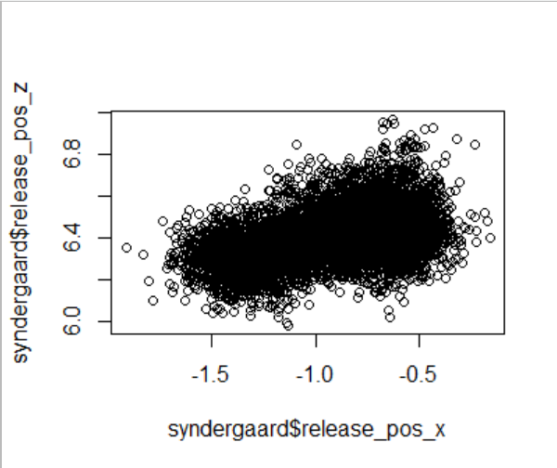
Syndergaard – Pitch Release Distribution

Slide 26
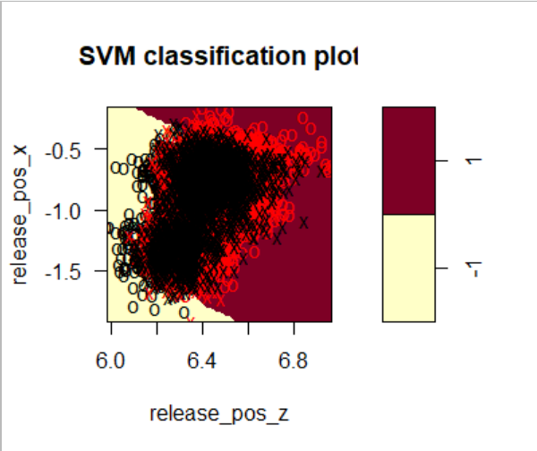
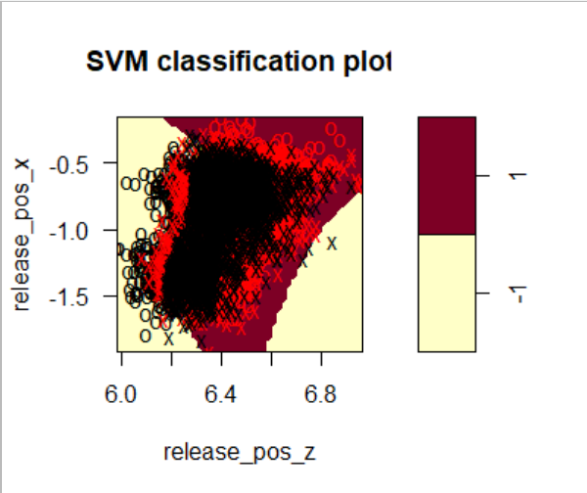
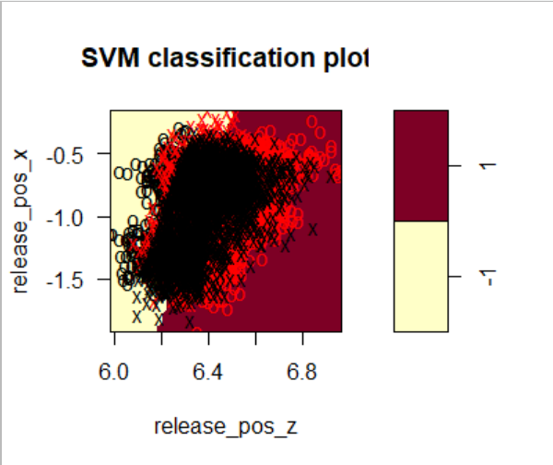
Syndergaard – SVM
Kernel = Polynomial
Accuracy 62.9%
Kernel = Radial
Accuracy 67.9%
Kernel = Linear
Accuracy 62.8%

Slide 27

Conclusion
Advanced analytics serve best as a complimentary feature to traditional coaching and scouting
Discovered trends prove insufficient to provide competitive advantage to opposing batters
Further research and analysis may reveal other useful insights
Professional pitchers have proven exceedingly difficult to predict through analytical models
Objective: Identify high-level trends in pitcher performance
The Astros had it right

